Slide 1
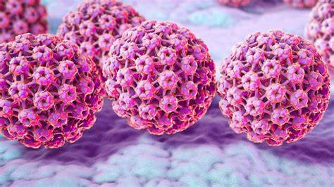
HPV Vaccination (Human Papillomavirus)
What you need to know

Slide 2
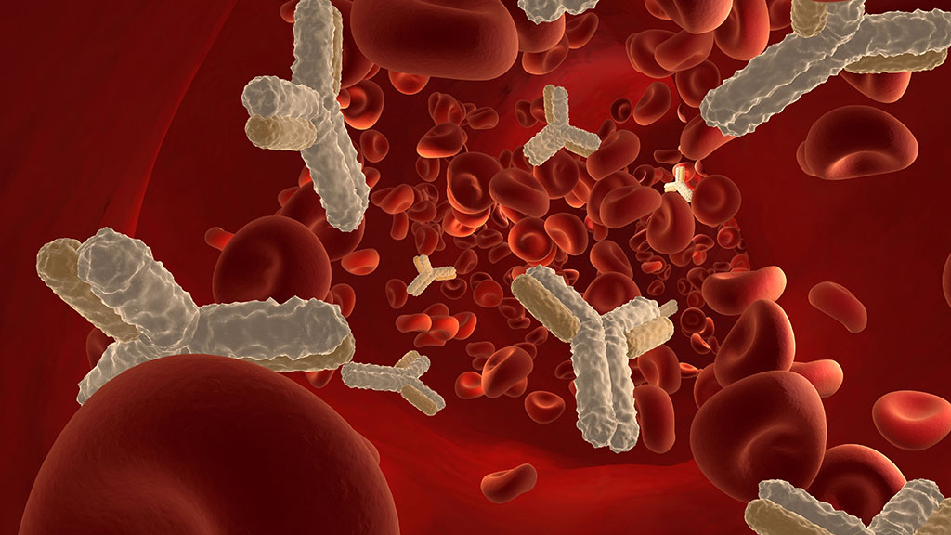
How do vaccines work?
Vaccines help to protect against many diseases. They are very safe and effective.
Vaccines contain antibodies that fight against specific diseases.
Once you have had a vaccine your immune system will create antibodies that will fight against the disease you were vaccinated against.

Slide 3
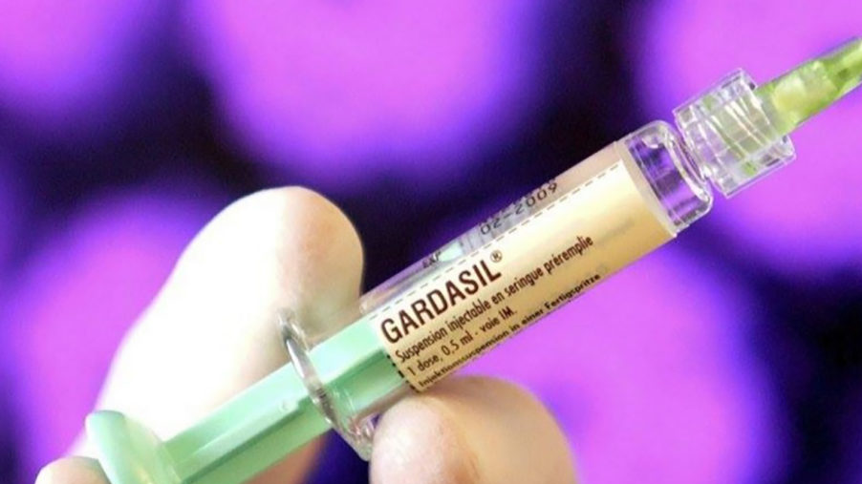
HPV Vaccine
The HPV vaccine helps protect against cancers caused by HPV, including:
cervical cancer
some mouth and throat (head and neck) cancers
some cancers of the anal and genital areas
It also helps protect against genital warts.

Slide 4
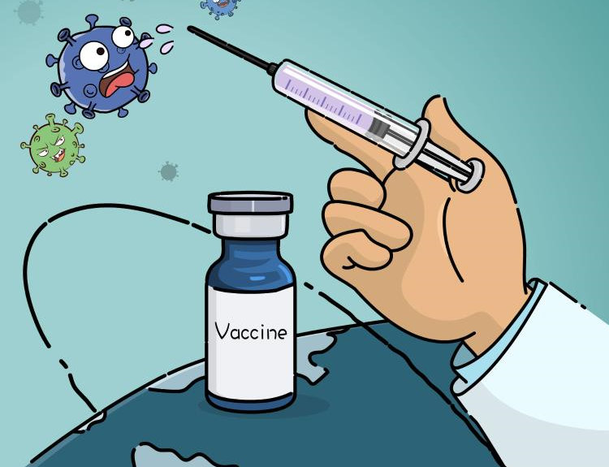
HPV Vaccine
The HPV vaccine is one dose and routinely offered to girls and boys aged 12 and 13 in school year 8.

Slide 5
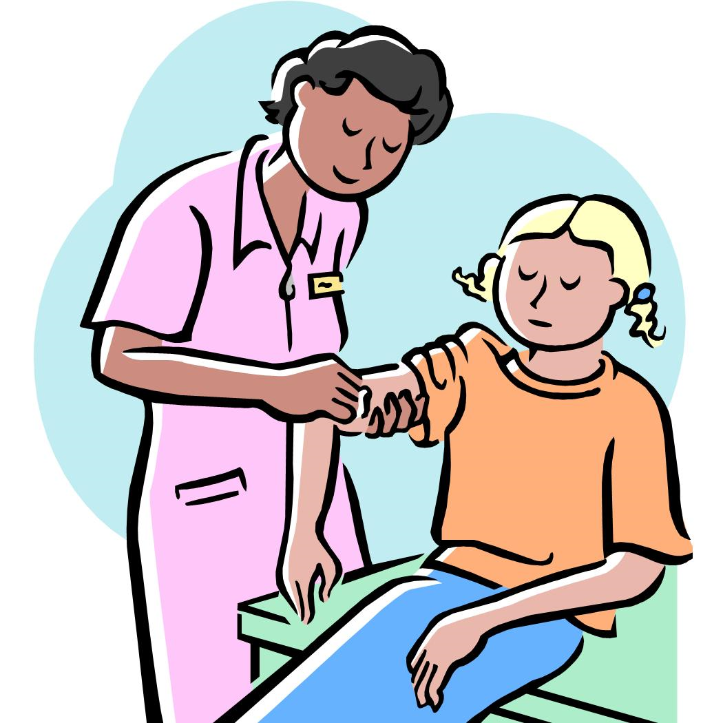
What will happen on the day of your vaccine?
You will go to a member of the team who will check your details.
Once checked in you will be seen by a nurse.
The nurse will explain what vaccine you are having
They will then ask questions related to your health
The vaccine will then be given
The nurse will give aftercare advice
Your parent/carer will receive an email to confirm you had the vaccination/s
Please wear loose fitting / short-sleeved school shirt, or T-shirt under your shirt, to enable easy access to the top of your arm.

Slide 6
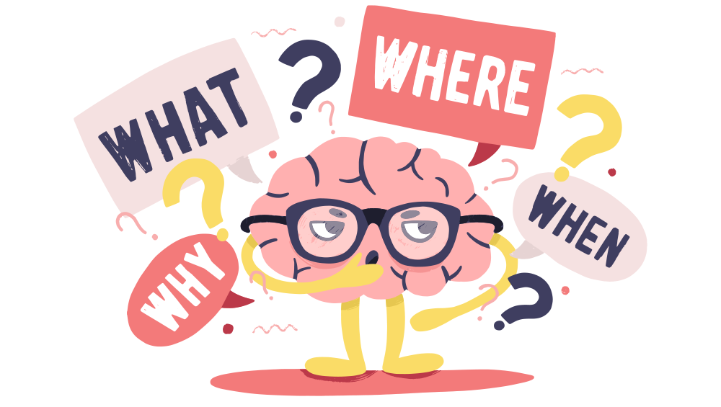
Any Questions?

